Slide 1
Personalized training recommendations
Helsana
Case Deep Dive
Arben Nuhija, Head of Health Platform
arben.nuhija@helsana.ch

Slide 2
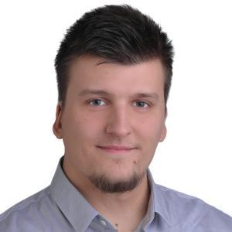
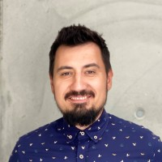
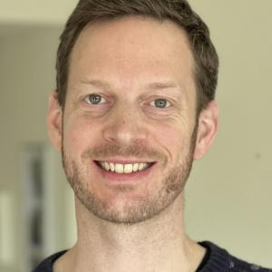
PERSONALIZED TRAINING RECOMMENDATIONS
Muhamed Ahmetovic Cloud Developer Solution Architect
HELSANA_Marc
Arben Nuhija IT Team Lead Health Platform
HELSANA_arbennuhija
Christian Bär Cloud Developer
HELSANA_Atti
Paulina Näf
MSc Life Sciences
Android/ML
HELSANA_Paulina

Slide 3
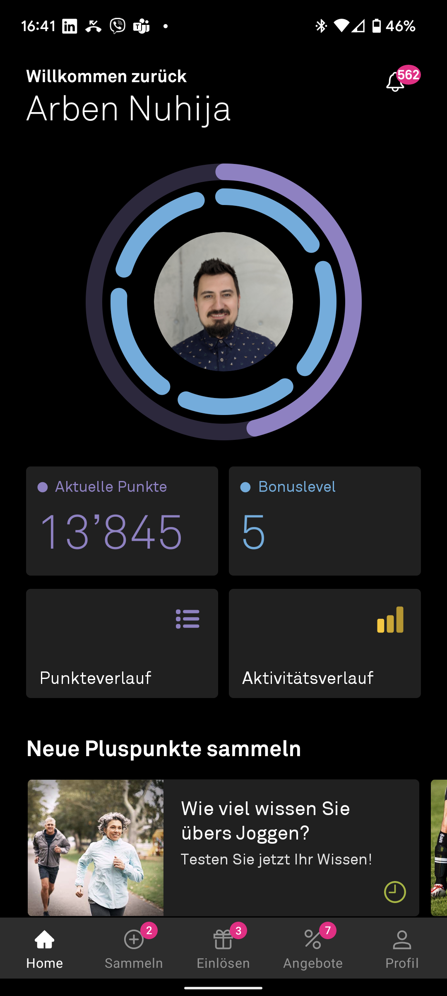
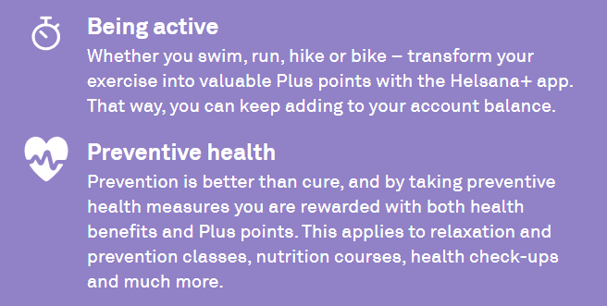
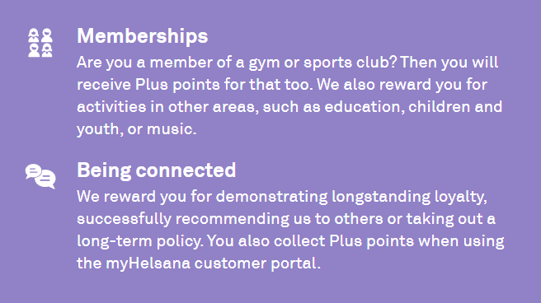
PERSONALIZED TRAINING RECOMMENDATIONS Health Apps

Slide 4
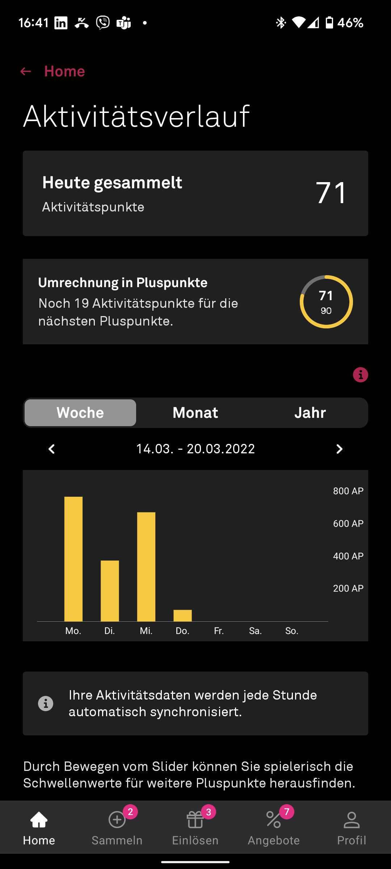
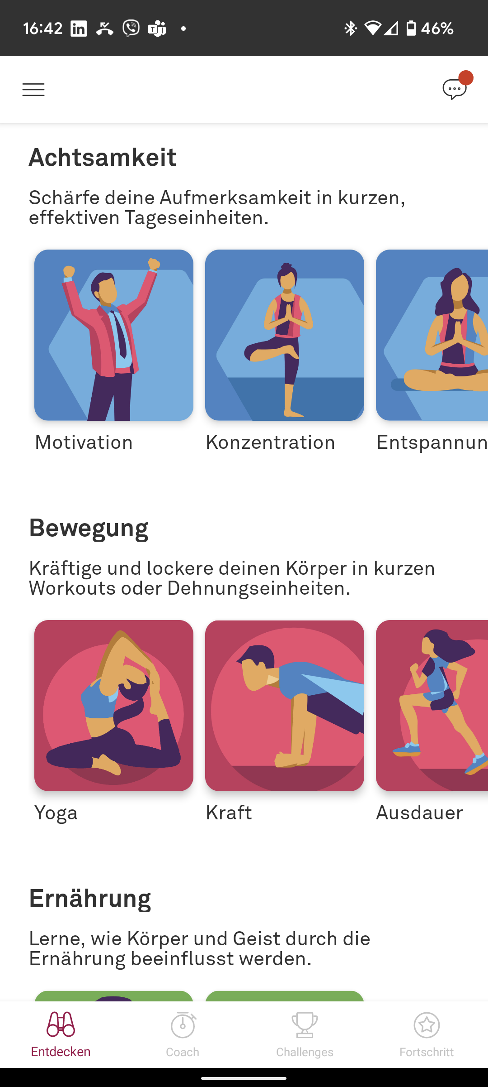
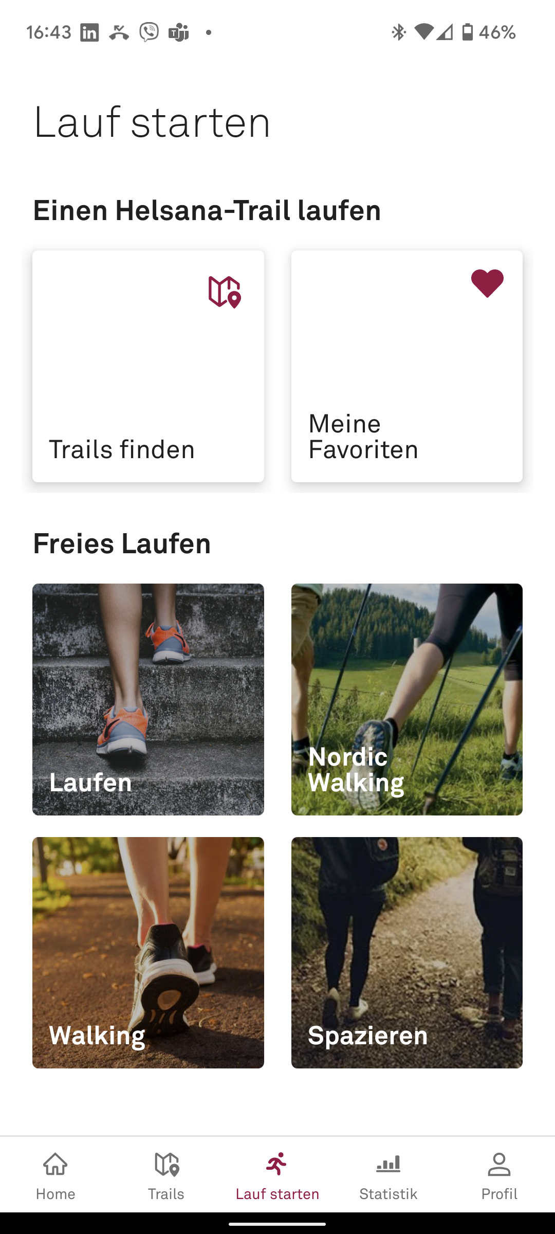



PERSONALIZED TRAINING RECOMMENDATIONS

Slide 5




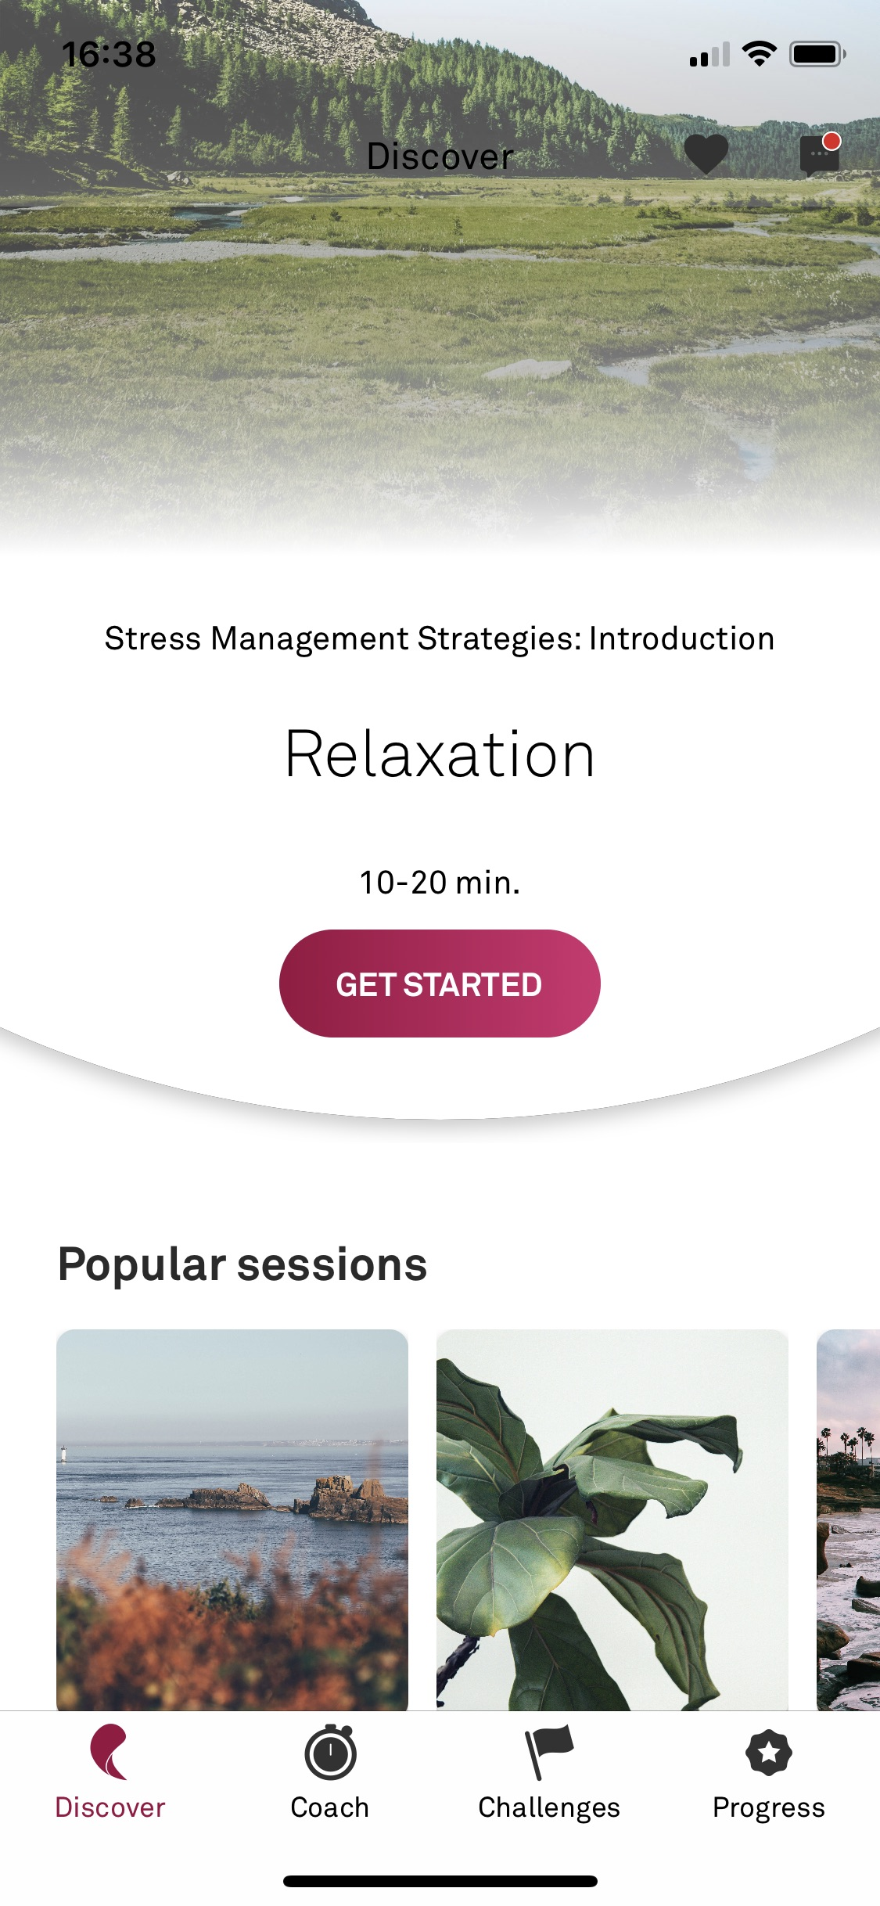
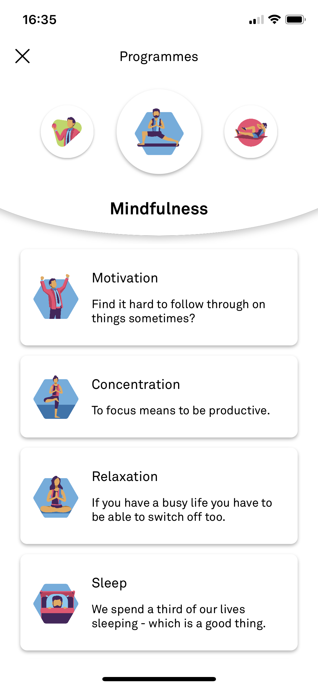
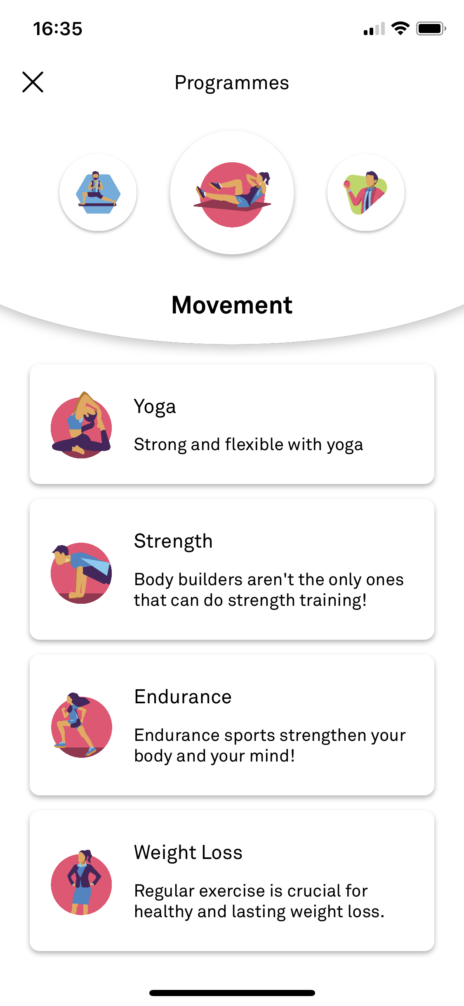
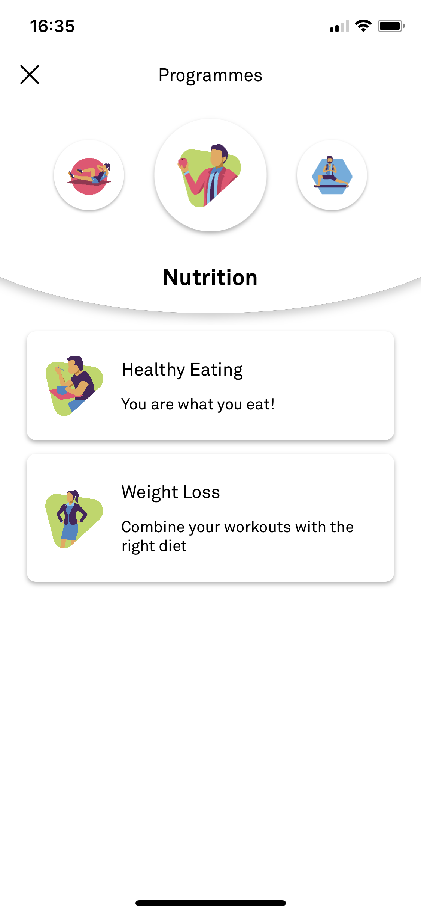






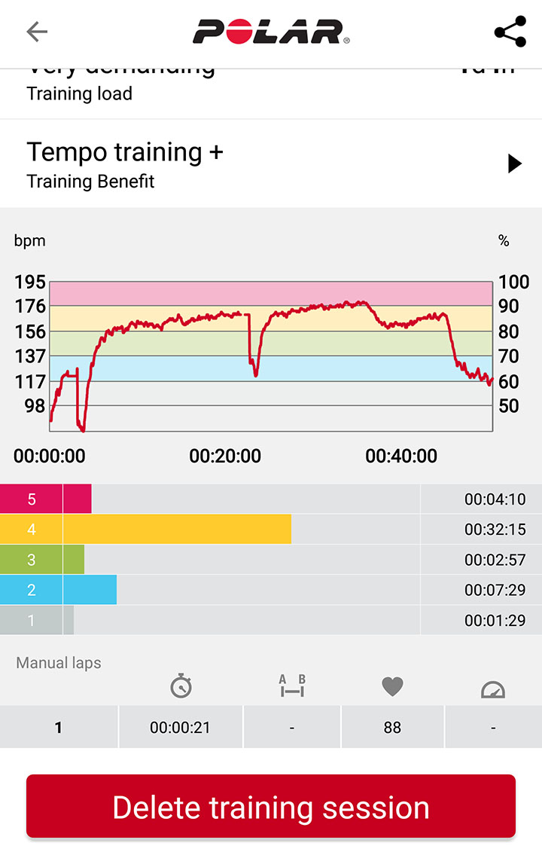


PERSONALIZED TRAINING RECOMMENDATIONS

Slide 6

PERSONALIZED TRAINING RECOMMENDATIONS
Personal recommendations

Slide 7
PERSONALIZED TRAINING RECOMMENDATIONS
Demo

Slide 8
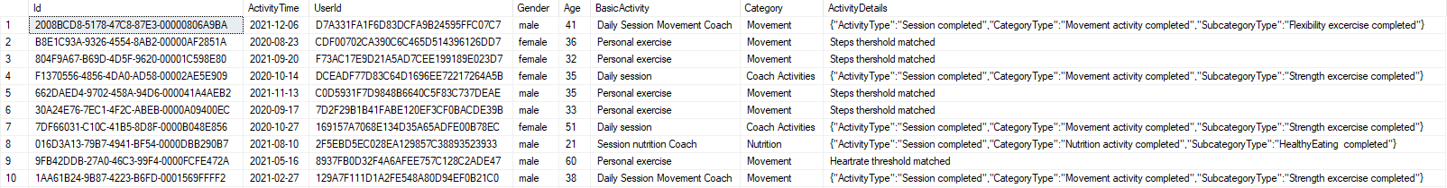
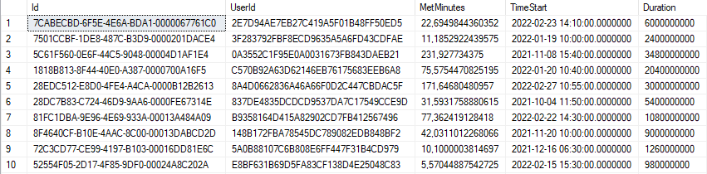
PERSONALIZED TRAINING RECOMMENDATIONS Data
Table: UserActivity
Table: Move

Slide 9
PERSONALIZED TRAINING RECOMMENDATIONS Data
Column: category
Coach Activities
Nutrition
Getting started
Mindfulness
Loyalty and Helsana
Movement
Challenges

